Slide 1
Fast approximate minimum spanning tree based clustering algorithm

Slide 2
Submitted by:
Md. Nahidul Islam (2028)
Md. Shakil Hossain (2023)
Md. Mahabubur Rahman (2024)
Submitted To:
Dr. Mohammad Abu Yousuf
Professor
Institute of Information Technology
Jahangirnagar University

Slide 3
Highlights
A fast approximate minimum tree based clustering algorithm is proposed
A novel centroid based nearest neighbor rule is presented
Much faster as compared to exact MST algorithms
Experiments on both synthetic and real datasets are carried out
Quality of clusters from the approximate MST is maintained

Slide 4
1. Introduction
MST-based clustering algorithm was initially proposed by Zahn. Basic idea is to identify and remove the inconsistent edges from the MST until required number of clusters are formed.
MST is a wellknown combinatorial optimization problem which has been widely used in many practical applications such as network design, image segmentation, cluster analysis etc.

Slide 5
2. Related work
1.Kruskal’s algorithm first sorts the edges in nondecreasing order by their weights. It starts with every vertex being its own tree and iteratively combines the trees by adding edges in the sorted order, discarding the edges whose addition results in cycle, until all the vertices are connected by the tree. The complexity of the algorithm is O(E log V).
2.The Prim’s algorithm starts from an arbitrary root vertex as the tree and then repeatedly adds the shortest edge that connects a new vertex to the tree until the tree connects all the vertices. The running time of the Prims algorithm is O(E log V). If Fibonacci heap is employed, the complexity of the algorithm reduces to O(E + V log V). Several fast MST algorithms have been studied in the

Slide 6
3. Clustering algorithm
Divide the dataset into k partitions.
Compute intra-partition edges considering each partition as a complete subgraph (Clique).
Identify neighboring partitions as well as the boundary points in the neighboring partitions.
Compute inter-partition edges between the neighboring partitions using the boundary points.
Construct approximate MST from the resulting

Slide 7
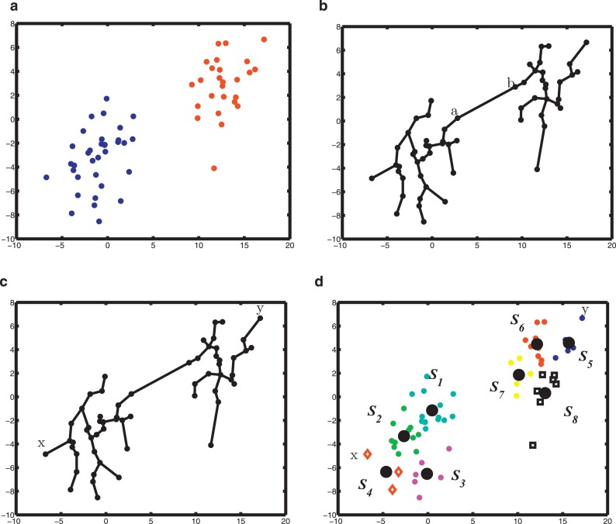
Fig. Early detection of longest edges using Preliminary partitions:
An example dataset with two clusters.
(b)MST constructed from complete graph of the dataset, removing the longest edge (a,b) results in desired clusters.
(c)Points x and y are far apart, edge (x, y) is not included in MST and hence distance computation between x and y play no role in clustering phase.
(d) Preliminary partitions of the dataset S = {S1, S2, · · · , S8}, center of each Si marked in
black solid dot; the nearest neighbors of x belong to the subsets S2 and S3, and hence distance computation between x and y is avoided.

Slide 8
Definition 1[Neighboring partitions]
Let S = {S1, S2, · · · , Sk} be the set of preliminary partitions generated by the proposed algorithm.
Let µi be the center of the partition Si and let Tµ be the MST constructed from the centers of the partitions. Two partitions Si and Sj are said to be neighbors iff the following is true.
d(µi , µj) ≤ max{ W(ei)}

Slide 9
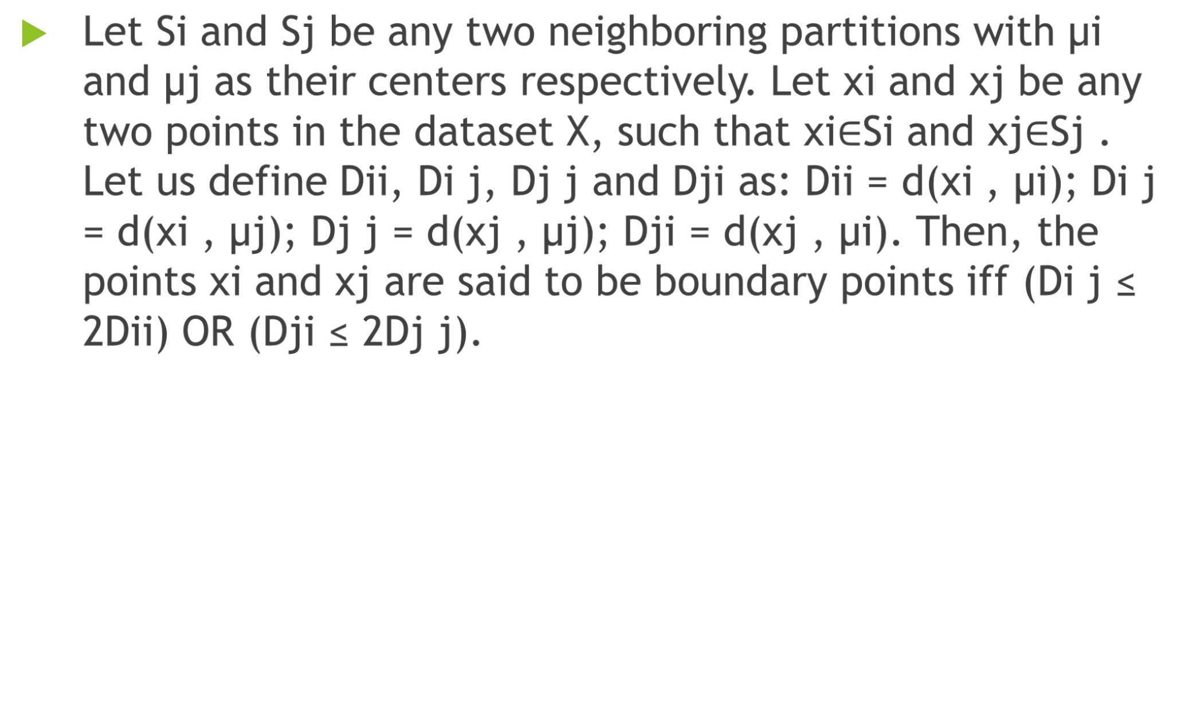
Definition 2 [Centroid Based Rule (CBR)]

Slide 10
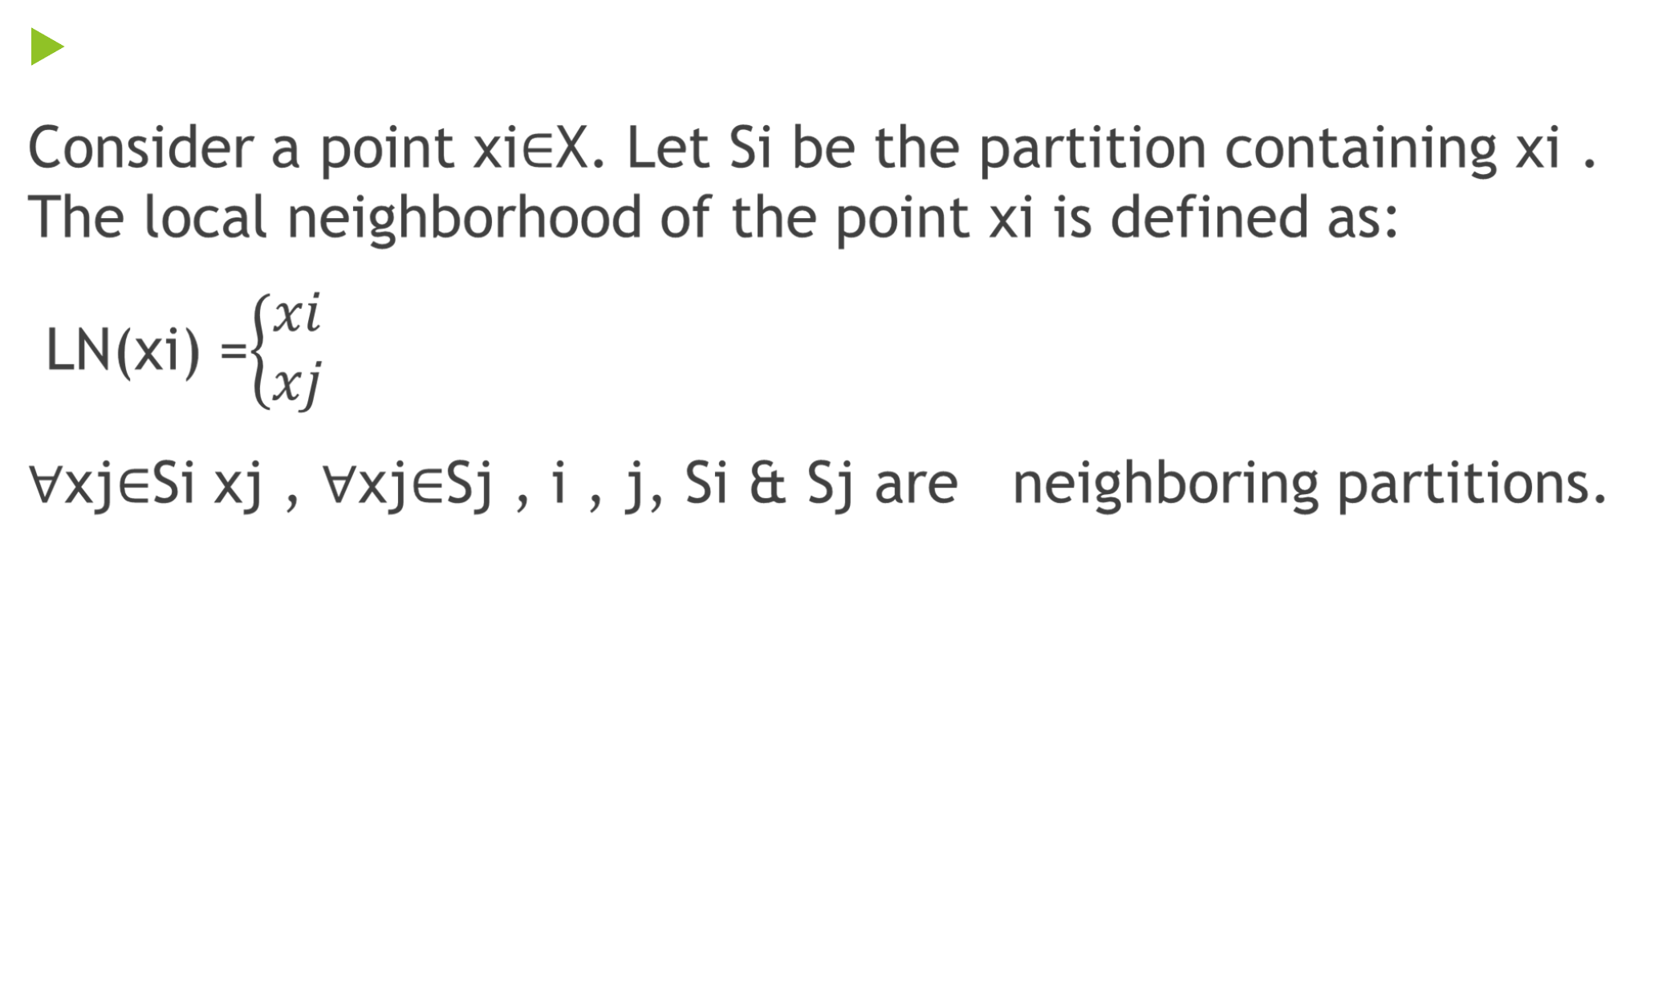
Definition 3 [Local Neighborhood]

Slide 11
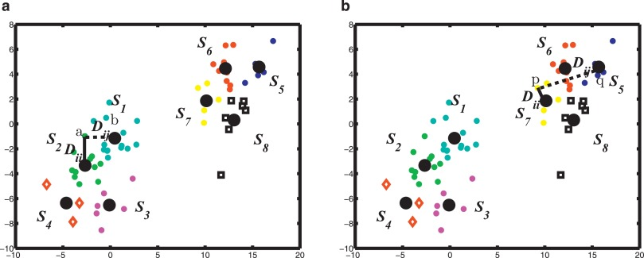
Fig. Centroid Based Rule (CBR):
For points a and b, (Di j 2Dii) and the edge (a, b) is considered during MST construction.
(b) Points p and q lie far apart (Di j , 2Dii) and the edge (p,q) is not necessary for MST construction.

Slide 12
4. Performance Analysis
In this section, we provide a theoretical analysis of the proposed algorithm PNNG. For the sake of clarity, PNNG with K-means based partitions is referred as KNNG and PNNG with Bi-means based partitions is referred as BNNG. Similarly the exact MST generated from the complete graph is referred as CG.
First, we derive a theoretical bound on the number of edges in the local neighborhood graph GLN = (V, E) generated by the algorithms KNNG and BNNG. Then, we obtain the complexity of generating MST from GLN.

Slide 13
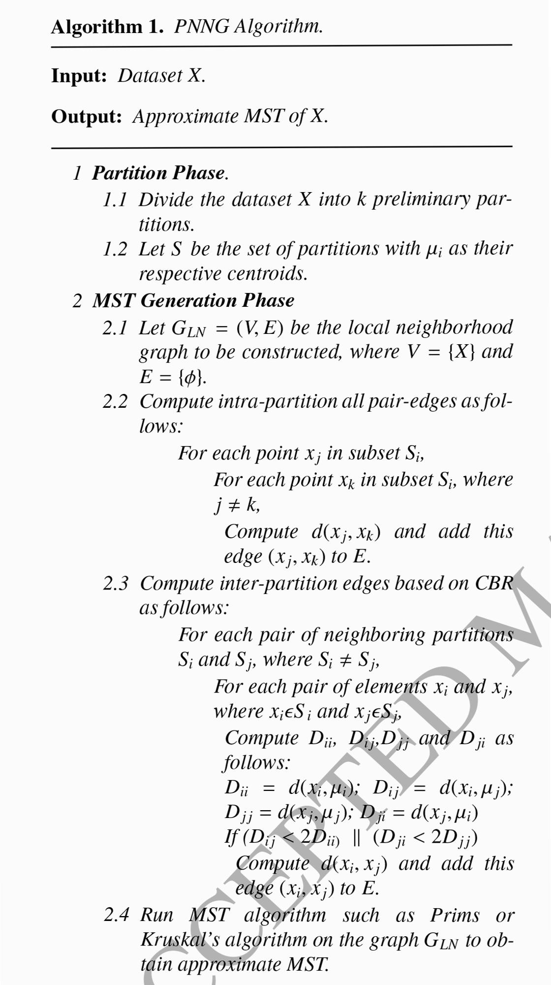

Slide 14
5. Experimental Analysis
As discussed earlier, the core of MST-based clustering is to identify and remove inconsistent edges (e.g., longest edges) of the MST to get desired clusters.
Performance of the proposed algorithm is compared with exact MST algorithms (CG) such as Prim’s as well as Kruskal’s algorithms.

Slide 15
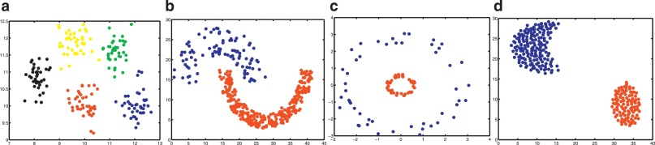
Fig. Synthetic datasets used in the experiments.
Gaussian dataset (Data1).
(b) Half-moon dataset (Data2).
(c) Cluster-inside-cluster dataset (Data3).
(d) Well-separated clusters dataset (Data4).

Slide 16
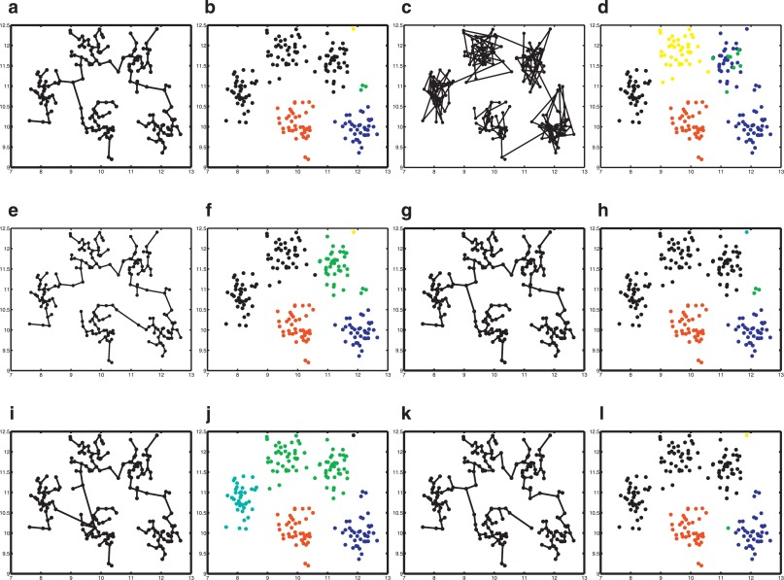
Fig. Comparison of algorithms on Gaussian dataset with number of clusters k = 5: MST and the clusters identified by removing k − 1 longest edges from the MST are compared.
(a) Exact MST constructed from complete graph. (b) Clusters from exact MST.
(c) Approximate MST from Wang-MST algorithm. (d) Clusters from Wang-MST.
(e)Approximate MST from Chen-MST algorithm. (f) Clusters from Chen-MST.
(g) Approximate MST from Zhong-MST algorithm. (h) Clusters from Zhong-MST.
Approximate MST from the proposed KNNG algorithm. (j) Clusters from KNNG.
(k) Approximate MST from the proposed BNNG algorithm. (l) Clusters from BNNG.

Slide 17
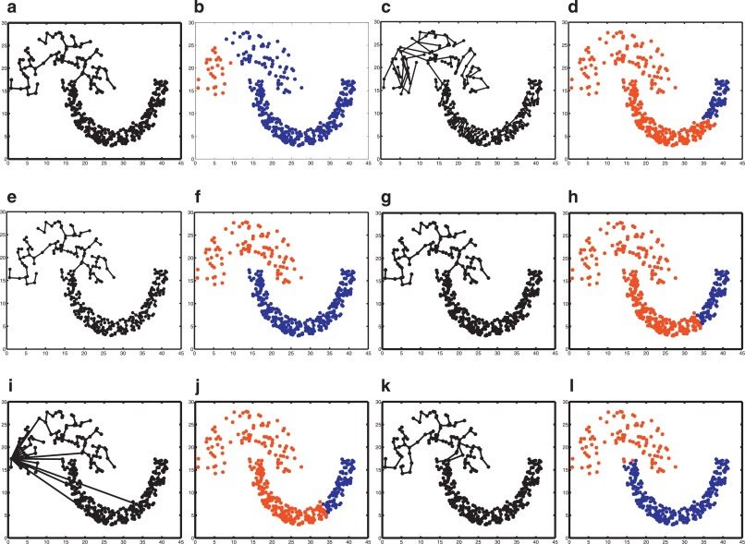
Fig. Comparison of algorithms on Half-moon dataset with k = 2: MST and the clusters identified by removing k − 1 longest edges from the MST are compared.
Exact MST constructed from complete graph. (b) Clusters from exact MST.
(c) Approximate MST from Wang-MST algorithm. (d) Clusters from Wang-MST.
(e) Approximate MST from Chen-MST algorithm. (f) Clusters from Chen-MST.
(g) Approximate MST from Zhong-MST algorithm. (h)Clusters from Zhong-MST.
Approximate MST from the proposed KNNG algorithm. (j) Clusters from KNNG.
(k) Approximate MST from the proposed BNNG algorithm. (l) Clusters from BNNG.

Slide 18
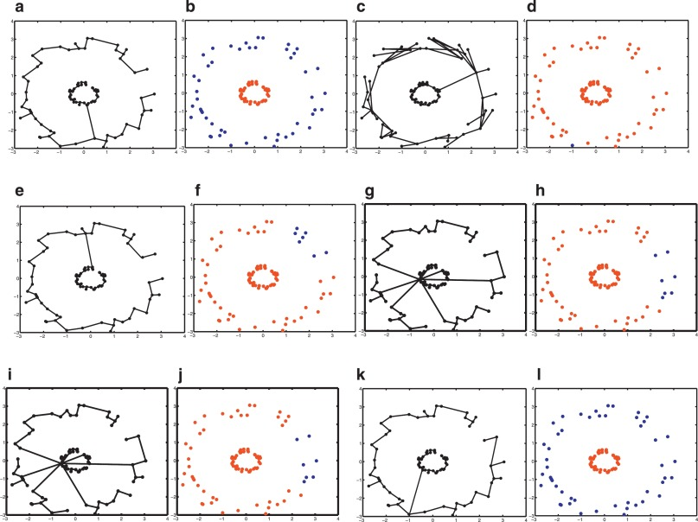
Fig. Comparison of algorithms on cluster-inside-another cluster dataset with k = 2: MST and the clusters identified by removing k − 1 longest edges from the MST are compared.
Exact MST constructed from complete graph. (b) Clusters from exact MST.
(c) Approximate MST from Wang-MST algorithm. (d) Clusters from Wang-MST.
(e)Approximate MST from Chen-MST algorithm. (f) Clusters from Chen-MST.
(g) Approximate MST from Zhong-MST algorithm. (h) Clusters from Zhong-MST.
Approximate MST from the proposed KNNG algorithm. (j)Clusters from KNNG.
(k) Approximate MST from the proposed BNNG algorithm. (l) Clusters from BNNG.

Slide 19
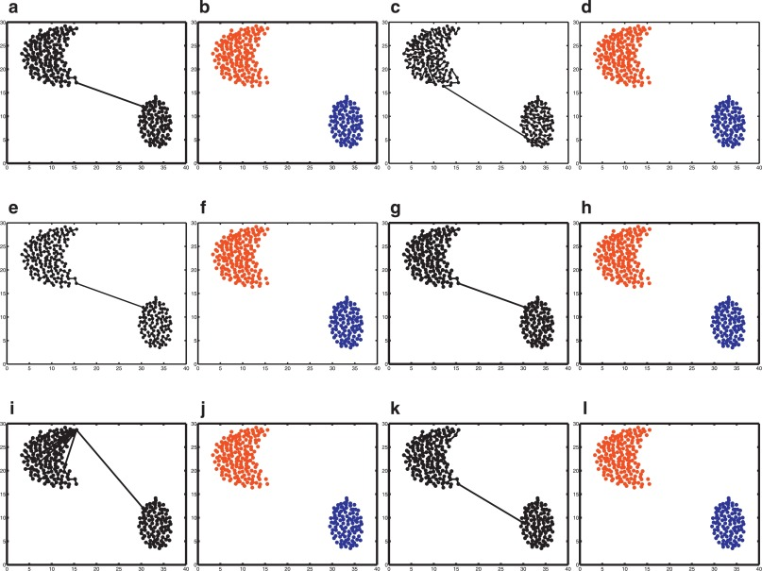
Fig. Comparison of algorithms on well-separated clusters dataset with k = 2: MST and the clusters identified by removing k − 1 longest edges from the MST are compared.
(a) Exact MST constructed from complete graph. (b) Clusters from exact MST.
(c) Approximate MST from Wang-MST algorithm. (d) Clusters from Wang-MST.
(e)Approximate MST from Chen-MST algorithm. (f) Clusters from Chen-MST.
(g) Approximate MST from Zhong-MST algorithm. (h) Clusters from Zhong-MST.
Approximate MST from the proposed KNNG algorithm. (j)Clusters from KNNG.
(k) Approximate MST from the proposed BNNG algorithm. (l) Clusters from BNNG.

Slide 20
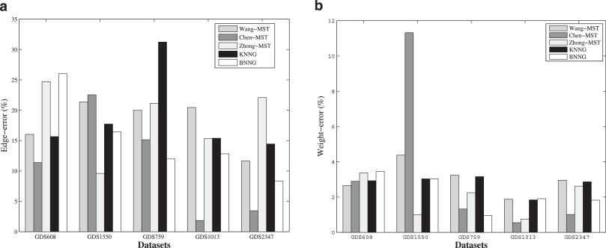
Fig. Edge and weight error analysis on real datasets

Slide 21
6. Conclusion
This paper proposed two efficient algorithms namely partition based near neighbor graph using Bi-means partitioning (BNNG) and partition based near neighbor graph using K-means partitioning (KNNG) for obtaining MST in the context of clustering in a less than quadratic time.
It has also observed that the proposed algorithms have shown considerable performance improvement over three recent fast approximate-MST algorithms namely Wang-MST Chen-MST and Zhong-MST.
As a future work, we will carry out an extensive analysis of local neighborhood graph generated by our proposed algorithm on various graph clustering algorithms.

Slide 22
Thank you!

